Slide 1
Making Linear Decisions
Linear Programming Part II

Slide 2
Google Colab
If you are using
https://colab.research.google.com
Please install CVXOPT and CVXPY
Just type (in the notebook on Colab)
!pip install cvxopt
!pip install cvxpy

Slide 3
Agenda
Digital Advertising
Linear Integer Programming
Lego Part II
Warehouse Location
You code
Supply Chain Strategy for Online Retailing
You model and code

Slide 4
Business Trivia
Why do firms advertise?

Slide 5
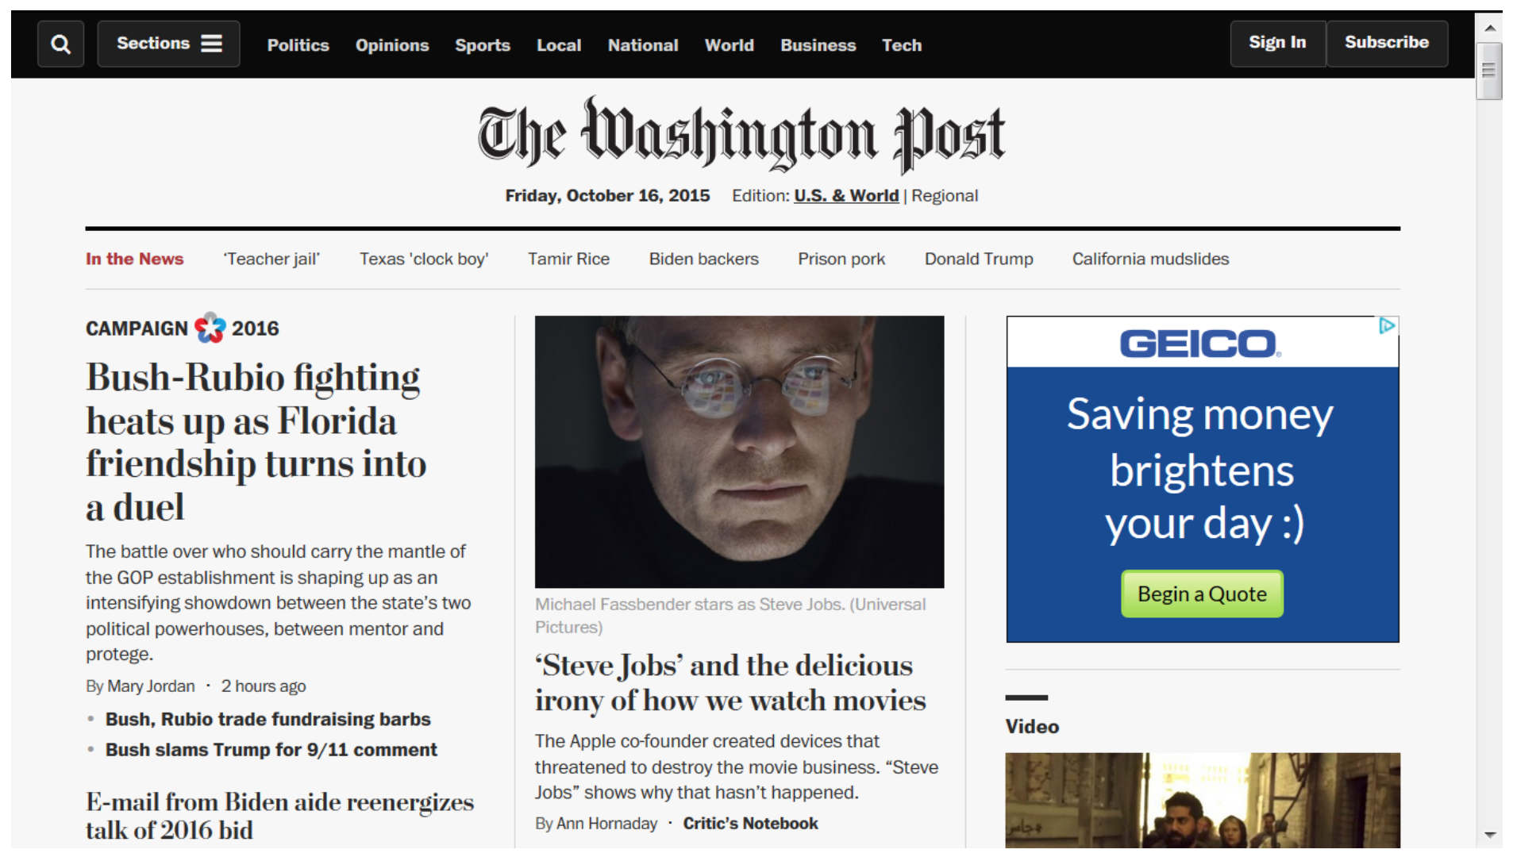
Display Advertising

Slide 6
Display Advertising
Content publishers such as The New York Times, The Washington Post and The Wall Street Journal generate revenue by using display advertisements.
The Washington Post's website contains several different sections including Sports and National, as can be seen above. The number of views each section gets per day can be estimated by analyzing historical data. Assume that the Sports section gets six million views per day and the National section get five million views per day.
Assume four companies, GEICO, Delta, T-Mobile and Capital One, wish to advertise on the Sports and National sections of the Washington Post and they contract directly with the newspaper. For each company, the contract specifies the number of times its display ads are shown in these two sections. The contracts sometimes also specify a total number of page views that can originate from any section of the newspaper. The page views promised by The Washington Post to each advertiser are summarized in the left table on the next slide.

Slide 7
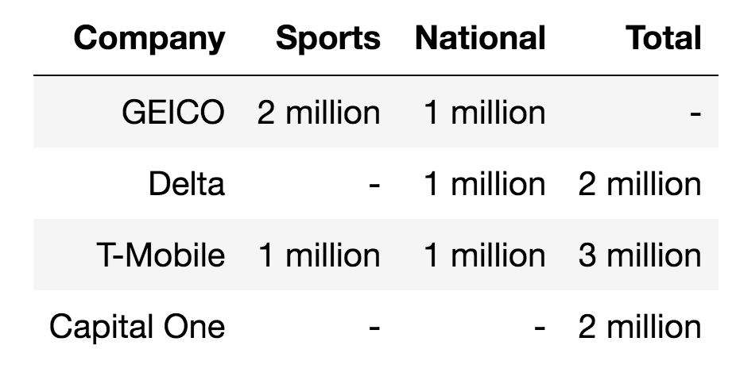
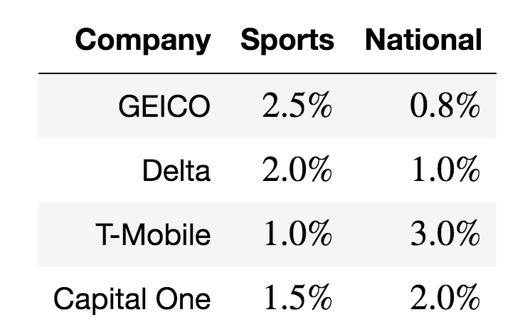
What is the optimal ad placement policy?
Assume that the contract also specifies that The Washington Post receives $2.30 per click-through from each of the four companies. However, not every page view leads to a click. If every 1000 views leads to 5 clicks, the click-through rate is 0.5%. Newspapers use historical data and tracking technologies to determine click-through rates. Assume that the relevant click-through rates are given in the right table below.

Slide 8
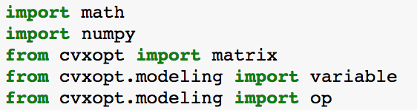
Modeling This is not an advertising problem
What are the decisions?
What is the objective function?
What are the constraints?
http://cvxopt.org/userguide/modeling.html

Slide 9
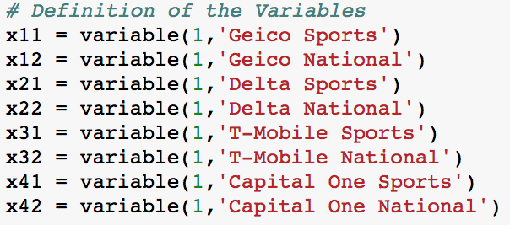
Decisions

Slide 10
Modeling
Assume that the contract also specifies that The Washington Post receives $2.30 per click-through from each of the four companies. However, not every page view leads to a click. If every 1000 views leads to 5 clicks, the click-through rate is 0.5%. Newspapers use historical data and tracking technologies to determine click-through rates. Assume that the relevant click-through rates are given in the right table below.

Slide 11
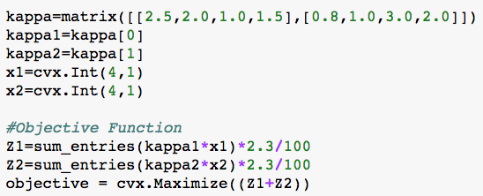
Objective Function

Slide 12
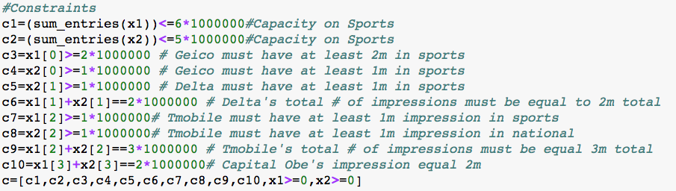
Constraints

Slide 13
Lego Last Week
You are the manager of a Lego Furniture production facility. The current resources available in your factory are 6 large orange Lego blocks and 8 small green Lego blocks.
You can make two kinds of furniture with your available Lego blocks. The first kind is a chair, which retails for $10 and takes 2 green blocks and 1 orange block to manufacture. The second one is a table, which retails for $16 and takes 2 green blocks and 2 orange blocks to manufacture. Both pieces are good sellers and you’ll be able to sell anything you produce.
What should you build in order to maximize revenues?
# of Chairs (x1): 2
# of Table (x2): 2
Optimal Revenue: $52

Slide 14
Lego This Week
You are the manager of a Lego Furniture production facility. The current resources available in your factory are 6 large orange Lego blocks and 11 small green Lego blocks.
You can make two kinds of furniture with your available Lego blocks. The first kind is a chair, which retails for $10 and takes 2 green blocks and 1 orange block to manufacture. The second one is a table, which retails for $16 and takes 2 green blocks and 2 orange blocks to manufacture. Both pieces are good sellers and you’ll be able to sell anything you produce.
What should you build in order to maximize revenues?
# of Chairs (x1): ?
# of Table (x2): ?
Optimal Revenue: $?

Slide 15
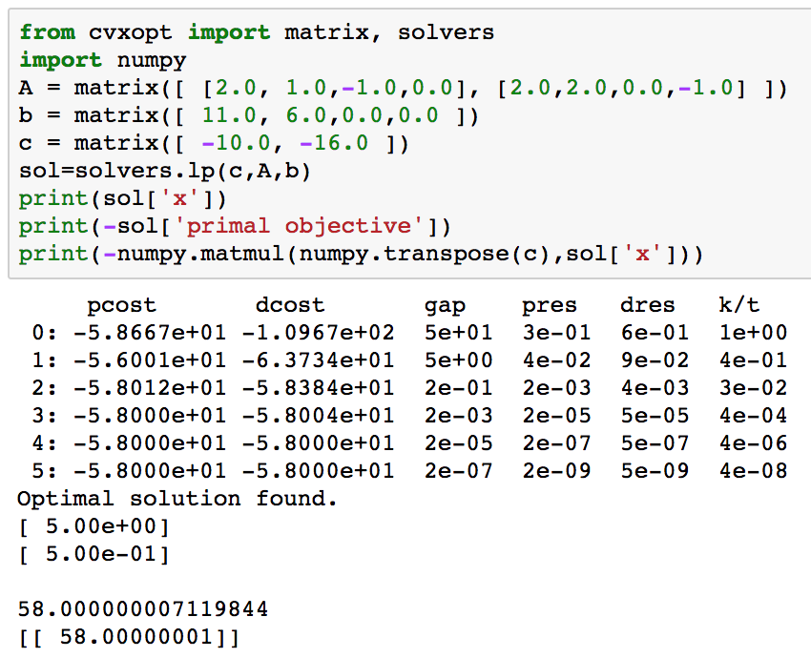
What do you think?

Slide 16
Better Modeling
Solution by brute force yields a solution that does not make sense
Rounding up the solutions will give a point that is outside of the feasibility set
We need to take into account the integer nature of the decision variables

Slide 17
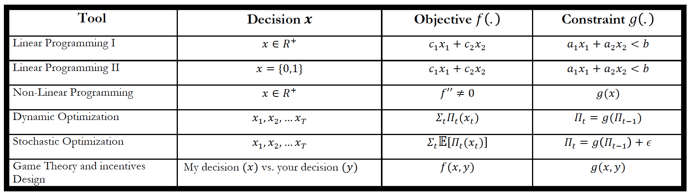
Integer Programming

Slide 18
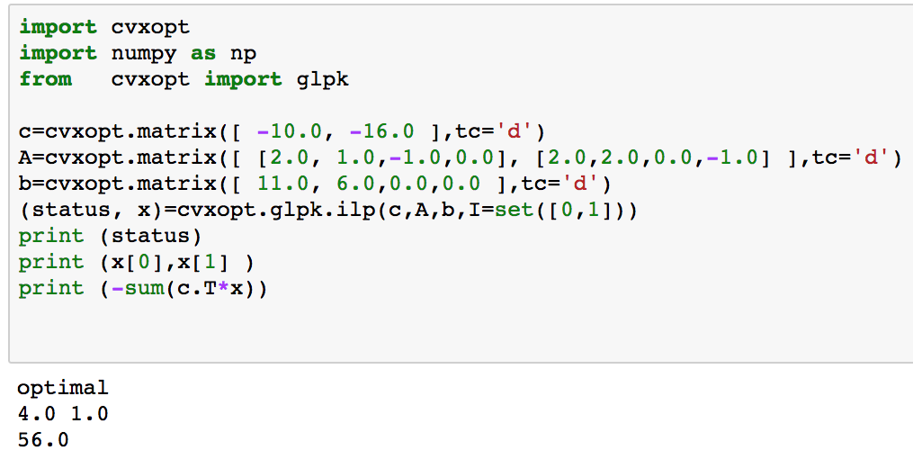
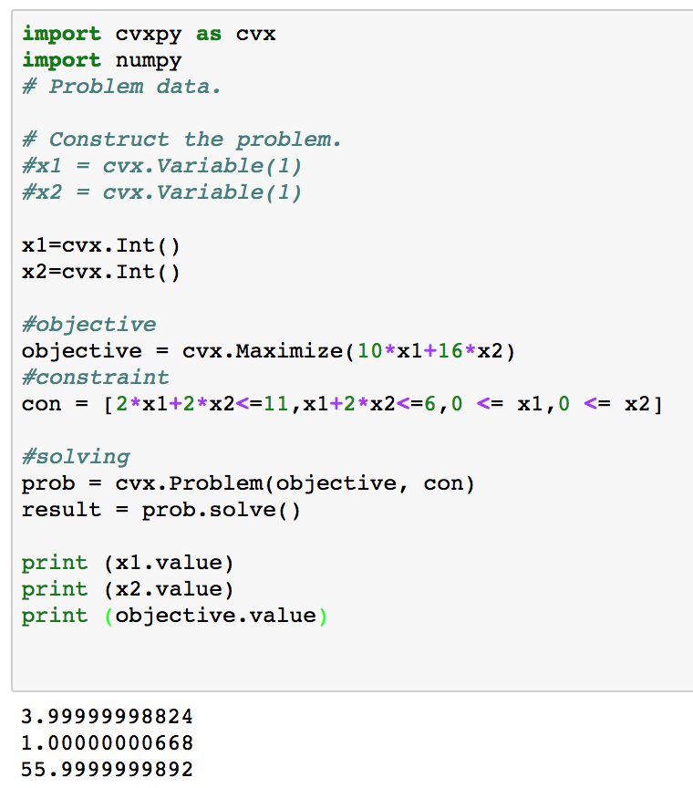
Solution to by Integer Programming
Solution with CVXOPT
Solution with CVXPY

Slide 19
Solution to by Integer Programming
I declare in the solvers which are the variables that are integers
Solution with CVXOPT
Solution with CVXPY

Slide 20
Solution to by Integer Programming
The decision variables
are Integers (in cvx, i.e., “Int( )”)
Solution with CVXOPT
Solution with CVXPY

Slide 21
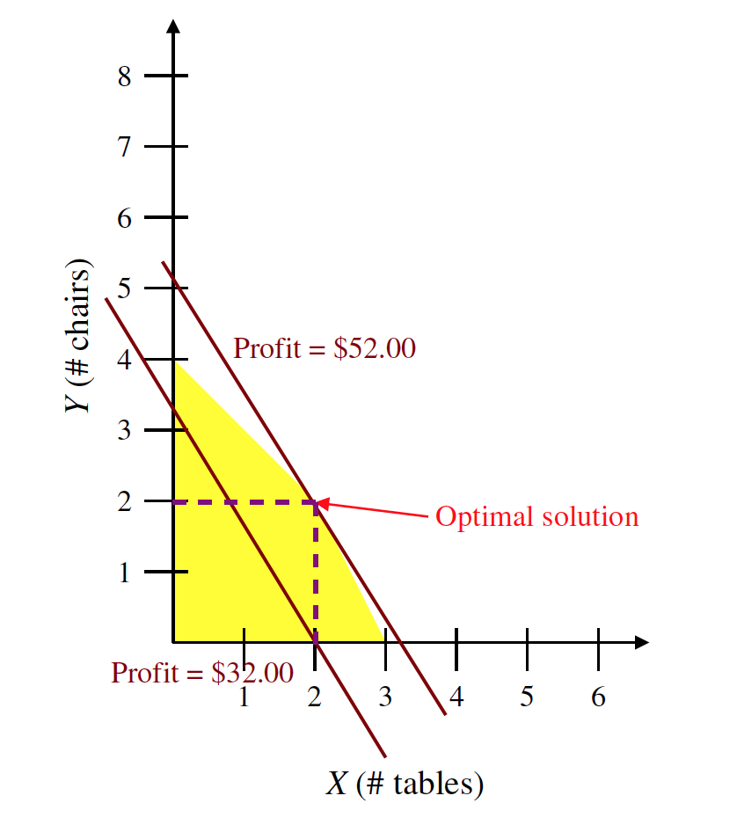
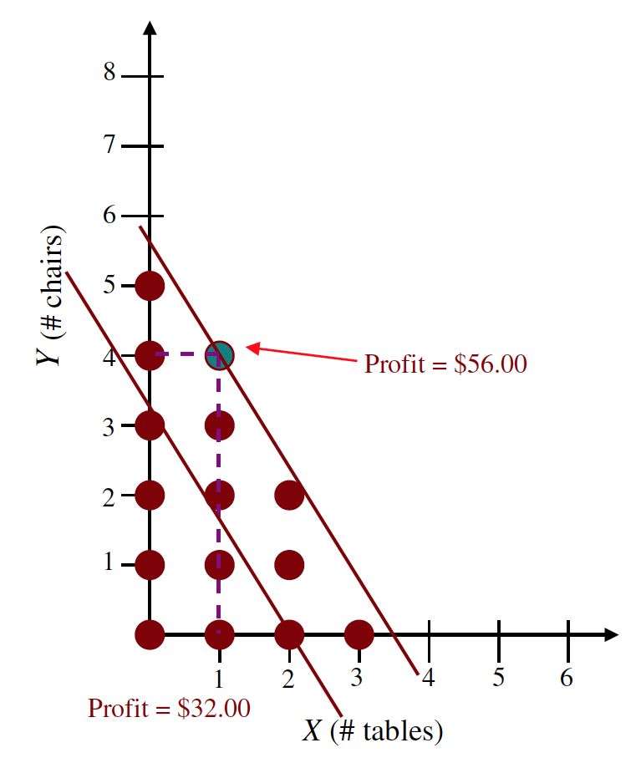
Visually

Slide 22
Integer Programming
Decision variables are not continuous but discrete
Mathematically, shadow price cannot be computed
Resort to “sensitivity analysis”

Slide 23
Binary Variables and Binary Choice
A binary variable, which takes on the values zero or one, can be used to represent a “go / no-go” decision.
X={0,1}
We can think in terms of discrete projects, where the decision to accept the project is represented by the value 1, and the decision to reject the project is represented by the value 0.

Slide 24
0-1 Constraints
When x_{i} and x_{j} represent binary variables designating whether projects i and j have been chosen, the following special constraints may be formulated:
At most k out of n projects will be chosen:
x_{j} < k
j
Project j is conditional on project i:
x_{j} - x_{i} < 0
Project i is a corequisite for project j:
x_{j} - x_{i} = 0
Projects i and j are mutually exclusive:
x_{i} + x_{j} < 1

Slide 25
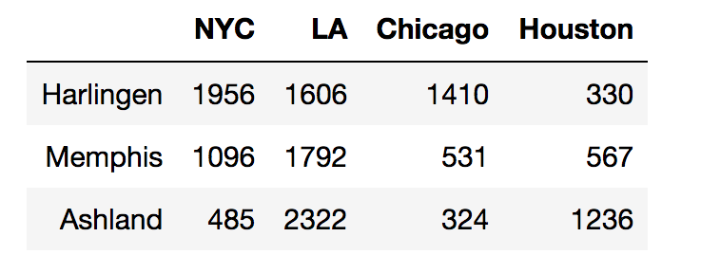
Warehouse Location Problem
You have to decide where to open warehouses to serve a customers located in four possible locations. The three possible locations are Harlingen, Memphis and Ashland. The four customer locations are NYC, LA, Chitown and Houston. The distance (cost) between the candidate locations and customer locations are given in the following table

Slide 26
Warehouse Location Problem
You have the decide where to open warehouses such that to minimize the cost of shipping while respecting some constraints. For instance, all customers must be served and you cannot open more than two warehouses.
Questions:
How many warehouses do you open?
Where are you going to location your warehouse(s)?
Who ships to whom?
What is the optimum?

Slide 27
p-Median Problem

Slide 28
You code

Slide 29
Linking Constraints with Fixed Costs
In many situations, activity costs are composed of fixed costs and variable costs, with only the variable costs being proportional to activity level.
Integer programming model, we can be helpful in integrating fixed cost components.

Slide 30
Incorporating Fixed Costs
We separate the fixed and variable components of cost.
In algebraic terms, we write cost as
Cost = f y + cx
Where f represents the fixed cost, and c represents the linear variable cost.
The variables x and y are decision variables, where x is a normal (continuous) variable, and y is a binary variable.

Slide 31
Linking Constraint
To achieve consistent linking of the two variables, we add the following generic linking constraint to the model:
x <= My
where the number M represents an upper bound on the variable x.
In other words, M is at least as large as any value we can feasibly choose for x.
Notes:
When y = 0 (and therefore no fixed cost is incurred), the right-hand side becomes zero, and the solver interprets the constraint as x <= 0.
Since we also require x >= 0, these two constraints together force x to be zero.
Thus, when y = 0, it will be consistent to avoid the fixed cost.
On the other hand, when y = 1, the right-hand side will be so large that the solver does not need to restrict x at all, permitting its value to be positive while we incur the fixed cost.
Thus, when y = 1, it will be consistent to incur the fixed cost.
Of course, because we are optimizing, Solver will never produce a solution with the combination of y = 1 and x = 0, because it would always be preferable to set y = 0.

Slide 32
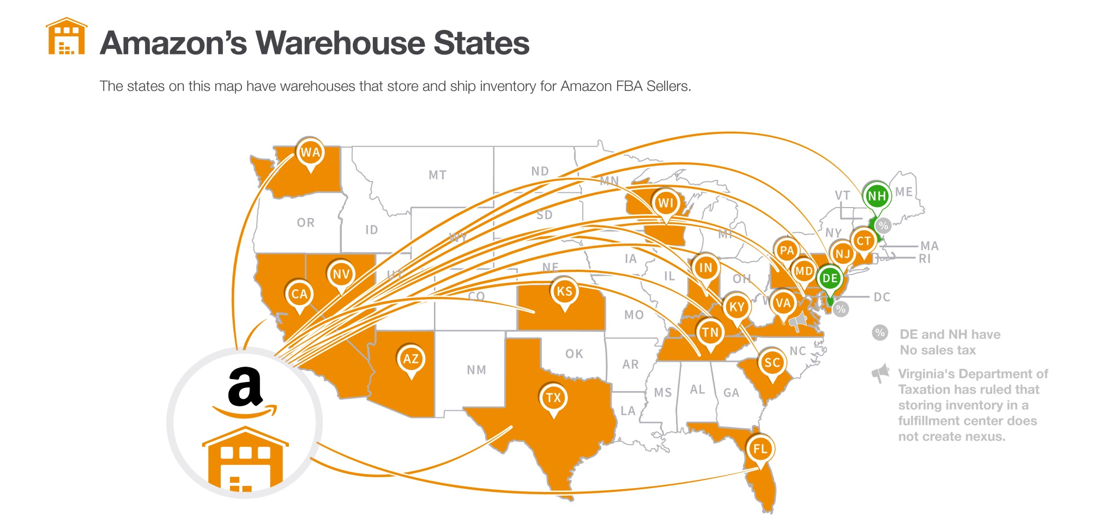
Amazon
In the last few years, due to the expansion of the services such as Amazon Prime and Amazon Prime Now, the importance of effectively selecting the location of new warehouses and/or choosing the right local warehouse to work with has dramatically increased

Slide 33
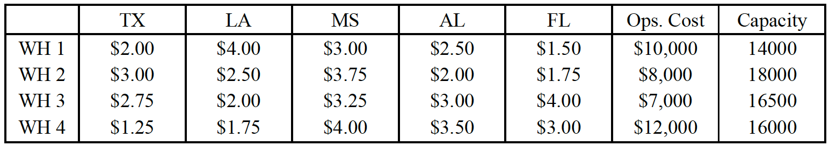
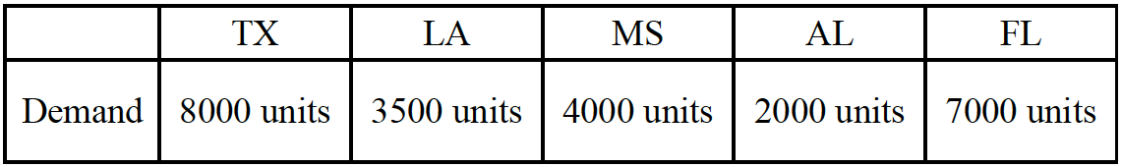
Because of the emerging demand, Amazon decided to start new warehouses in the Gulf Coast. Based on their studies, four potential locations for warehouses have been identified, each of which having a specific capacity and also a specific average cost-per-unit for shipping to any of the five Gulf Coast states. The capacity of each warehouse and its operating cost, in addition to the average cost-per-unit for shipping a product to any of the states are given in below, as well as demand from each state.

Slide 34

Questions
What is the minimal total cost for Amazon’s supply chain?
Which warehouses should Amazon operate?
Additional information on such problems:
http://examples.gurobi.com/facility-location/
https://www.sciencedirect.com/science/article/abs/pii/S0377221703008191
https://optimization.mccormick.northwestern.edu/index.php/Facility_location_problems

Slide 35

Modeling
What are the decision variables?
What are the constraints?
What is the objective function?

Slide 36
Business Trivia
What are the differences between:
Fixed costs vs. variable costs
Economies of scale vs. Economies of scope

